Slide 1


SHIBAURA
INSTITUTE
OF TECHNOLOGY
Tokyo, Japan
Learn from the world, contribute to the world

Slide 2
Introduction

Slide 3
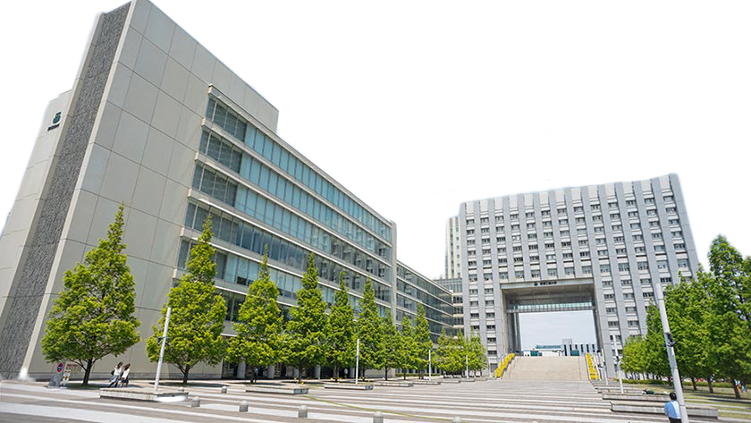
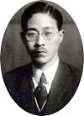
Mission Statement
Nurturing practical engineers
who learn from society and contribute
to society
SIT aims to foster scientists and engineers who can contribute to the sustainable growth of the world by exposing students to culturally diverse environments where they learn to cope with, collaborate with, and have ever-lasting friendships with fellow students from around the world.
Founded by
Dr. Shiro Arimoto in 1927
2

Slide 4
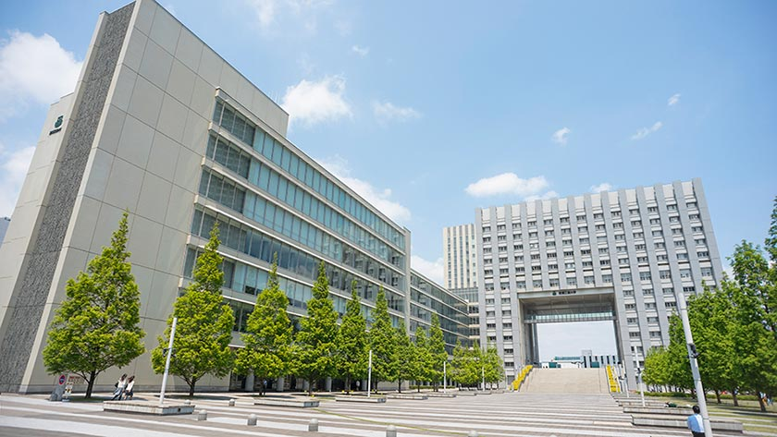
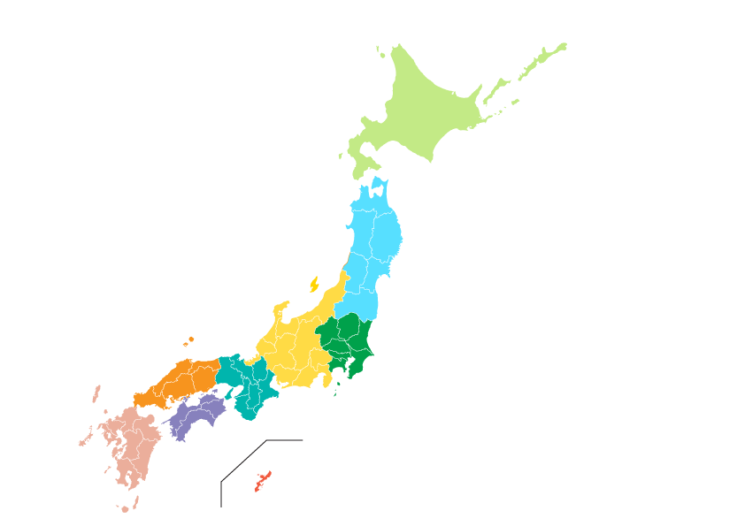
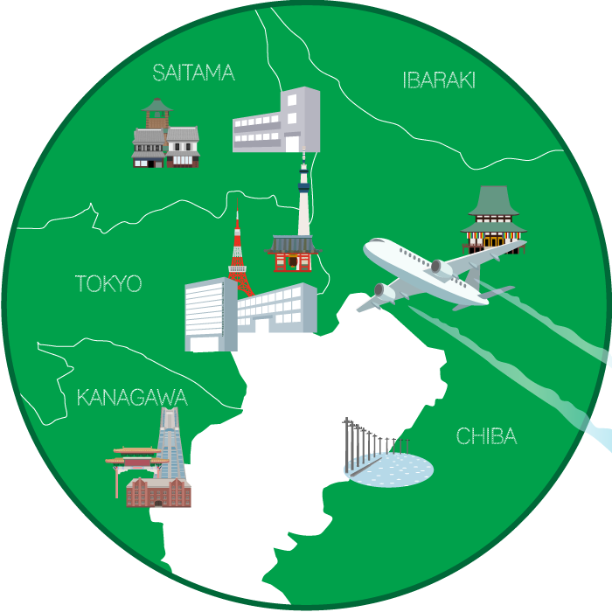
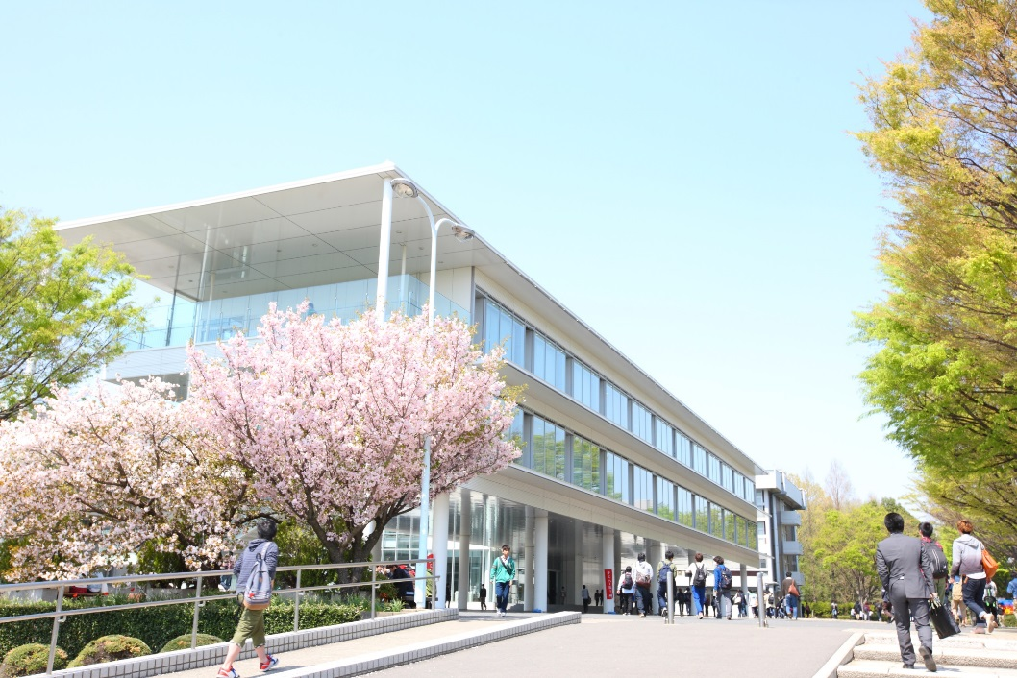
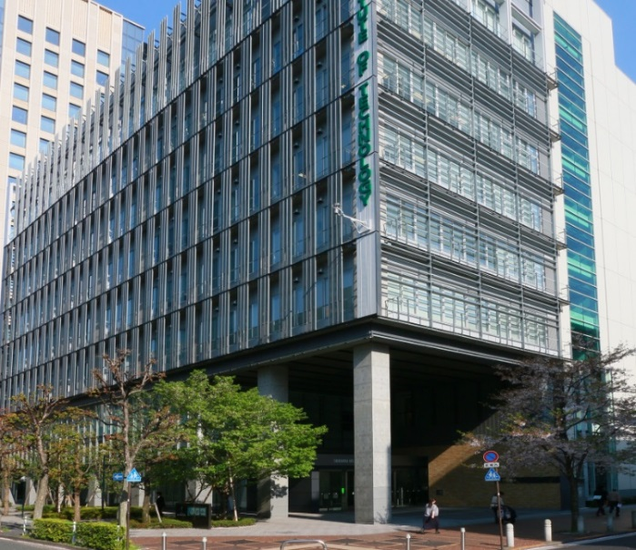
Campus Location
Toyosu Campus
３
CAMPUS
Locations in
The Tokyo Area
Omiya Campus
Shibaura
campus

Slide 5

9,089
Total Enrollment
AY2020-2021
4,255
997
2,092
665
1,080
College of Engineering
School of Architecture
College of Systems Engineering and Science College of Engineering and Design
Graduate School
Undergraduates 8,009
Graduates 1,080
4

Slide 6
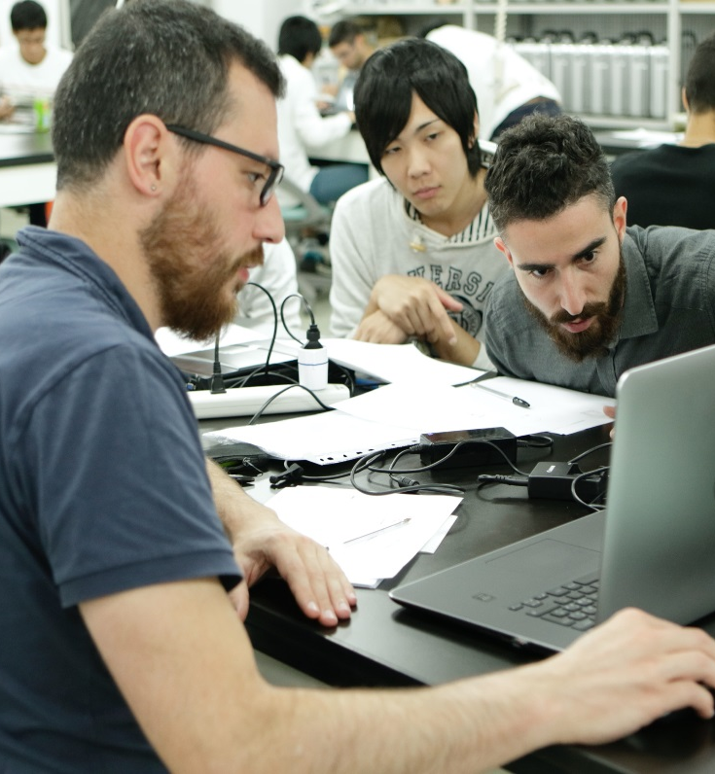
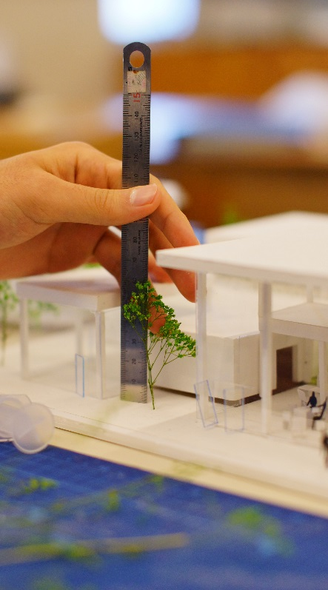
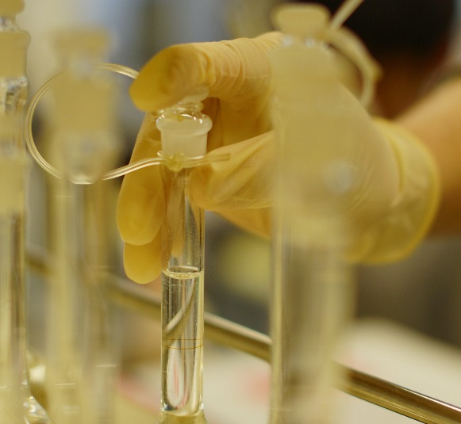
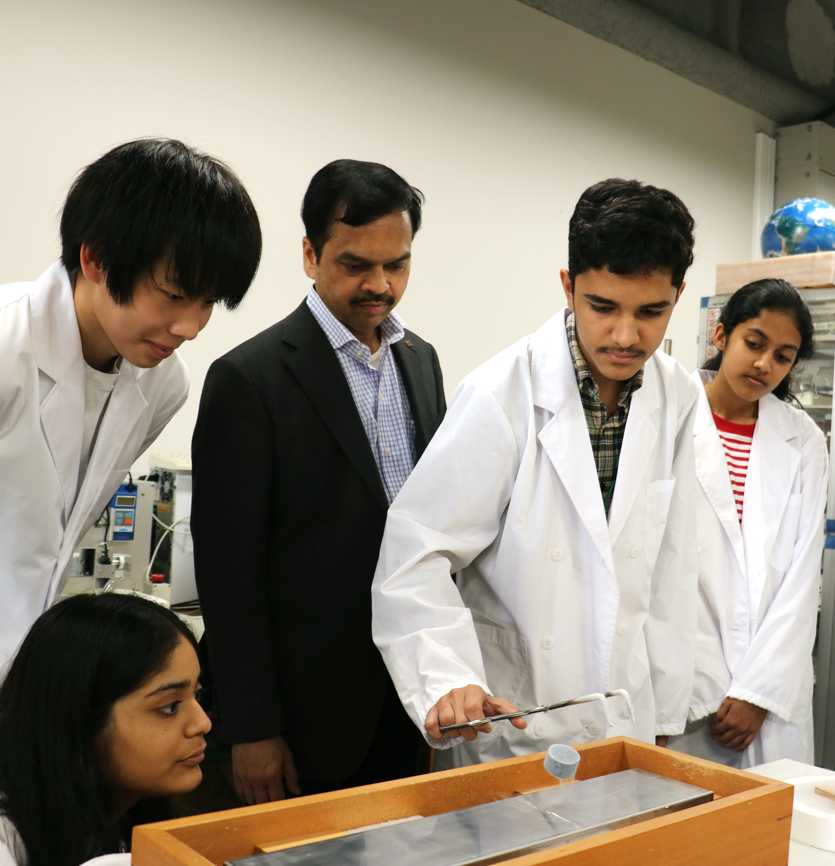
Fields of Study
16 Departments
in 3 Colleges and 1 School
&
1 Graduate School
Your Future Starts Here
5

Slide 7

SIT holds 16 departments
Covers the most of the majors in the field of Science and Technology.
Engineering
Systems Engineering
and Science
9
Depts.
Mechanical Engineering
5
Depts.
Electronic Information Systems
Engineering Science and Mechanics
Machinery and Control Systems
Materials Science and Engineering
Architecture and Environment
Systems
Applied Chemistry
Bioscience and Engineering
(2 Courses)
Electrical Engineering
Mathematical Sciences
Electronic Engineering
Engineering and Design
Communications Engineering
Information Science and Engineering
1Dept
Engieering Design (2 Fields)
Civil Engineering(2 Courses)
Architecture
1Dept
Architecture（3 Courses）

Slide 8
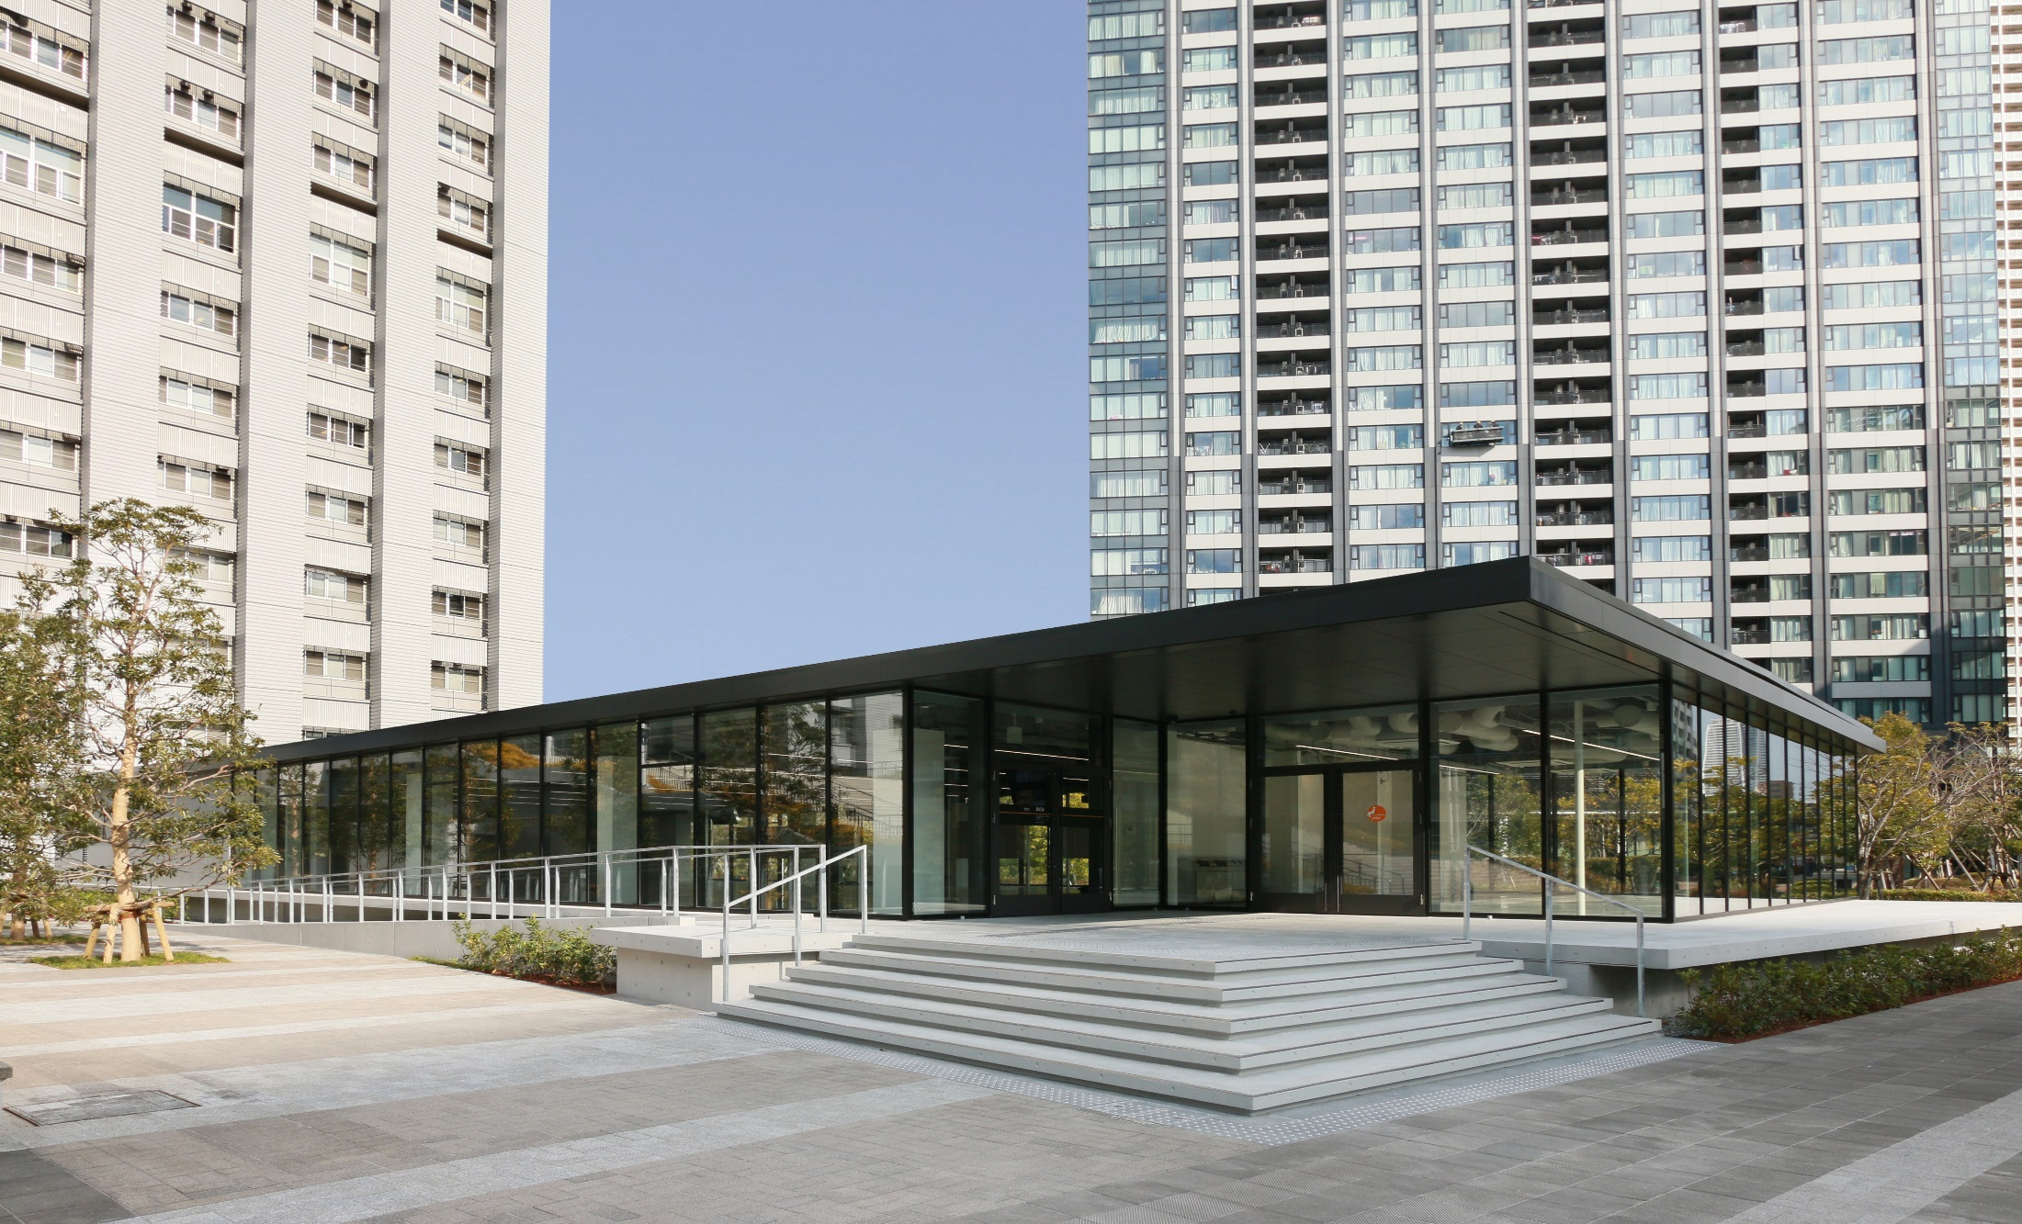
SIT Areas of Study in Graduate School of Engineering and Science
Master’s Program
Doctoral Program
7
Courses
Electrical Engineering and Computer Science
２Courses
Regional Environment Systems
Materials Science and Engineering
Functional Control Systems
Applied Chemistry
Mechanical Engineering
The number of graduate school courses is smaller than the number of the undergraduates departments due to the fact that one course may consist of multiple departments.
Architecture and Civil Engineering
Systems Engineering and Science
Global Course of Engineering and Science

Slide 9






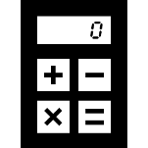

FIELDS OF STUDY
Electrical/Electronic/Information
Materials/
Applied Chemistry
Architecture/
Civil Engineering
7 Major Academic
Field
7 MAJOR
ACADEMIC
FIELDS
Mechanical
Design
Mathematical
Sciences
Biotechnology

Slide 10
Internationalization

Slide 11

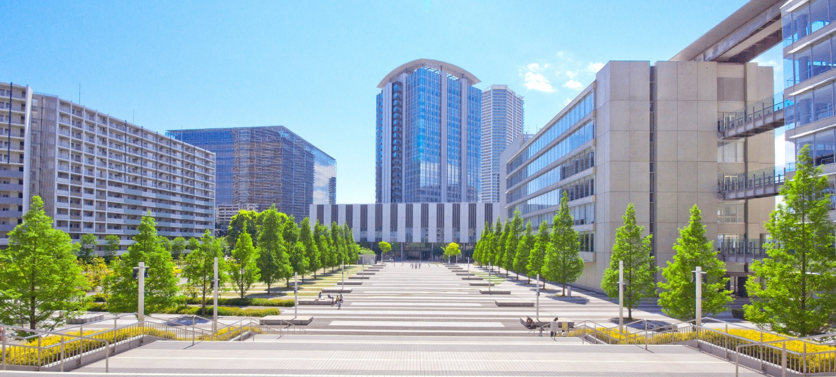
Top Global University
Project
Government chose 37 UNIVERSITIES to be role models for the globalization of Japanese educational institutions.
SIT is the ONLY private science and engineering university
in Japan to receive federal funds for this project.
10

Slide 12
Our Students Mobility Goals
11

Slide 13




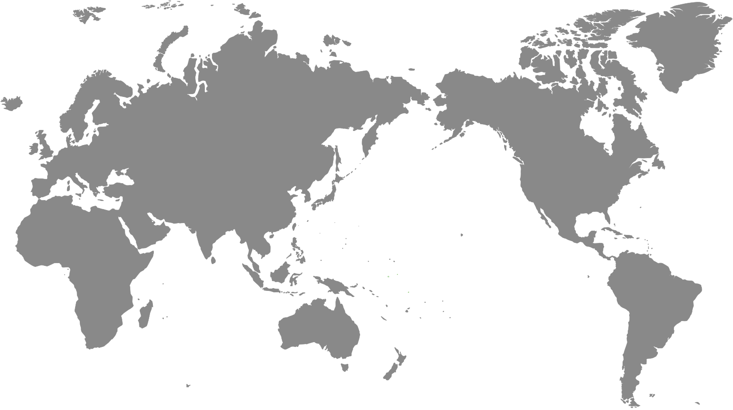











Total Number of
International Students
2019
1,692
Number of International Students (Top 15)
495
China
212
Thailand
South Korea
144
Malaysia
130
Taiwan
104
Indonesia
90
Brazil
85
Vietnam
66
Total Number of
International Students
2019
India
58
Sri Lanka
33
31
1,692
Mexico
Italy
28
France
25
25
Poland
Austria
16

Slide 14
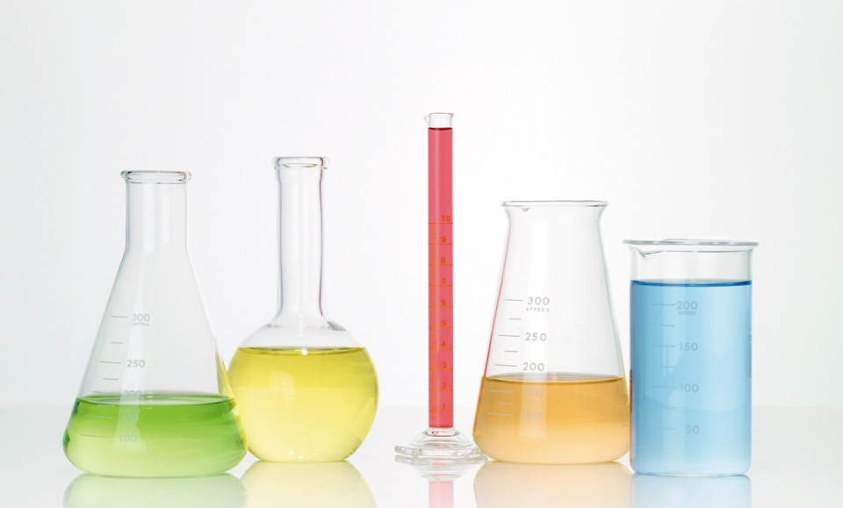
Targets for Year 2023
Study-abroad experience among Domestic Students
In 2015
712 Students
9 %
|
In 2023
2700 Students
100%
once in 4 years
International professors
In 2015
76 Professors
25.2%
|
In 2023
180 Professors
60%
Courses offered
in English
International Students
In 2015
501 students
6 %
|
In 2023
2,820 students
29.4%
Undergraduate
In 2015
120 Courses
|
In 2023
1,200 Courses
34%
Graduate
In 2015
80 Courses
|
In 2023
420 Courses
93%
Plan to provide
at least one
Study-Abroad Opportunity
13

Slide 15
Non-degree programs

Slide 16
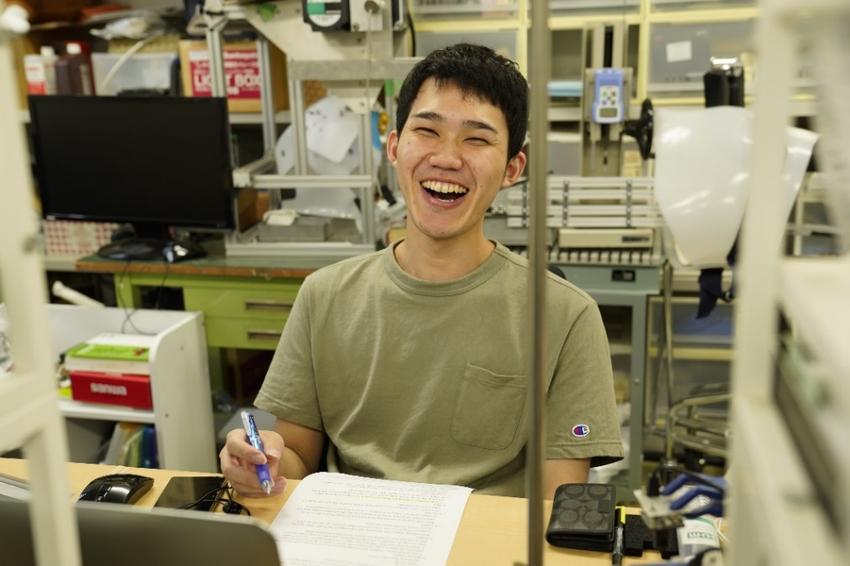
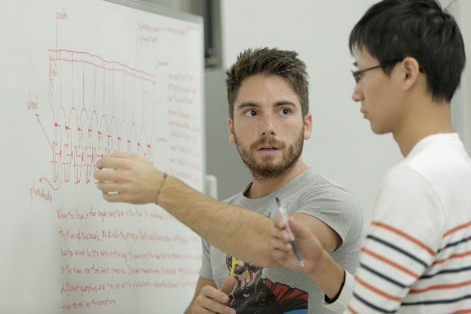
Mobility Programs
SIT MOBLITY
PROGRAMS
(Non-Degree Seeking)
Course-Taking Sandwich
Program
for
Graduates ＆Undergraduates
Research Exchange/Laboratory Internship Program
for
Graduates ＆Undergraduates
15

Slide 17
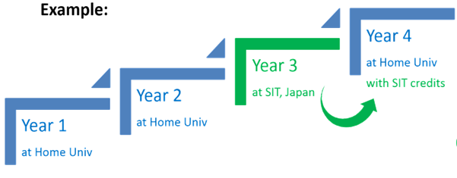
Course Taking Sandwich Program
More than 100 courses are offered in English.
Number of Participants:
250 students
Eligibility : Both undergraduate and graduate students
CEFR B2 or above English proficiency
Duration : 1 or 2 Semesters (half a year or whole year)
Spring semester: April – July Fall semester: September - January
Scholarship : JPY40,000 per month during the program for qualified students
Application period : (Fall entry) April 1st-30th (Spring Entry) October 1st-31st
https://www.shibaura-it.ac.jp/en/study/exchange_programs/sandwich.html

Slide 18
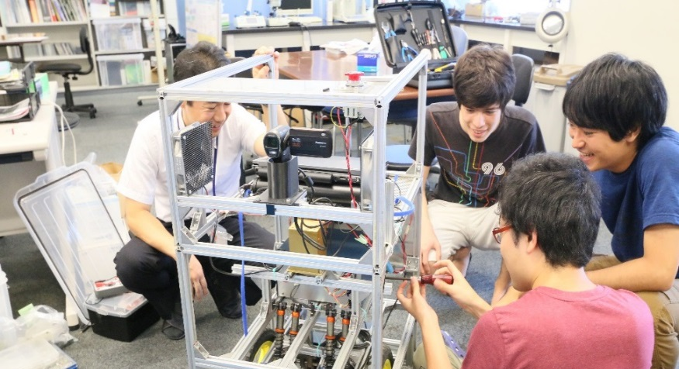
Research Exchange/Laboratory Internship Program
Conducting research under the supervision of SIT professor
Number of Participants:
200 students
Eligibility : Junior, senior and graduate students
Duration : 8 working days - 1 year
Scholarship : JPY40,000 per month during the program for qualified students
Application period : 6 entry period(cycles) in one year.
https://t-web.shibaura-it.ac.jp/en/
https://www.shibaura-it.ac.jp/en/study/exchange_programs/research.html

Slide 19
Why Non-Degree Program?
Studying at Japanese University with very low price.
( Besides the registration fee of JPY30,000,
no fees will be charged for partner university students.)
2) Broadening knowledge by learning
different perspectives in your field.

Slide 20











Cost of Living in Tokyo
Below is a rough estimate of living costs
Average
Expenses
JPY
107,000
SOURCE: JASSO

Slide 21
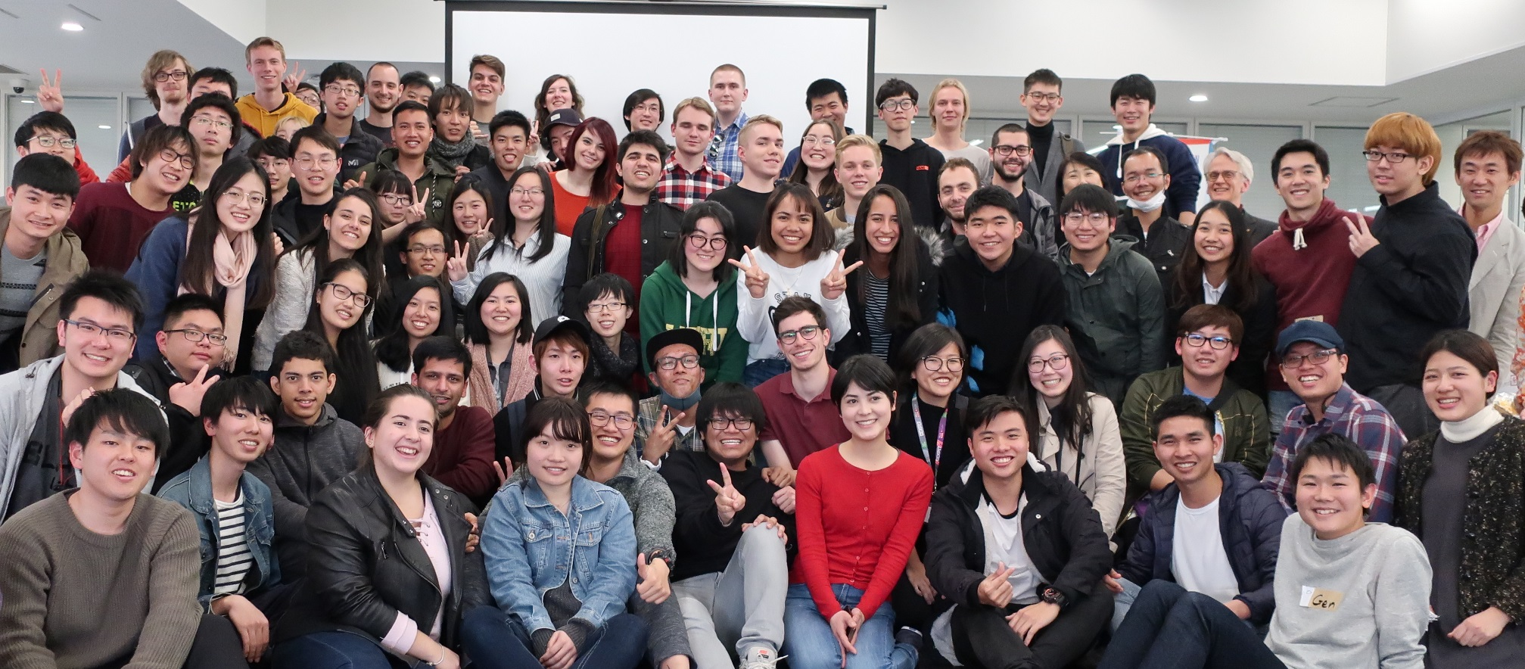
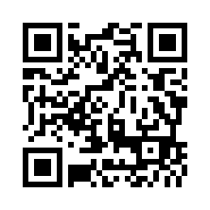
ANY
Questions?
Please contact us at
kokusai@ow.shibaura-it.ac.jp
We look forward to receiving your application!
Vist Us
www.shibaura-it.ac.jp/en/
20

